Slide 1
Industrial Economics
PPT - 4
Elasticity of Demand and Supply,
Price Elasticity, Income Elasticity, Cross Price Elasticity of Demand

Slide 2
Elasticity ?
Elasticity: Response of QD or QS
  A measure of the
  responsiveness of quantity
  demanded (QD) or quantity
  supplied (QS) to a change in
  one of its determinants
Price Elasticity of Demand
    Responsiveness of quantity demanded
    of a good to a change in the price of that commodity.

Slide 3
The Price Elasticity of Demand and Its Determinants
Availability of Close Substitutes
Goods with close substitutes tend to have more elastic demand because it is easier for consumers to switch from that good to others. Eg: Tea or Coffee
Necessities versus Luxuries
Necessities tend to have inelastic demands (Eg: Food products, Rice, Vegetables, etc), whereas
luxuries have elastic demands (Eg: Gold, Branded goods, etc).
Definition of the Market
Depends on how we draw the boundaries of the market.
Narrowly defined markets - tend to have more elastic demand than broadly defined markets because it is easier to find close substitutes for narrowly defined goods.
Time Horizon Goods tend to have more elastic demand over longer time
horizons. When the price of petrol rises, the quantity of petrol demanded falls
only slightly in the first few months. Over time, however, people buy more fuel efficient
cars, switch to public transportation, and move closer to where they work.
Within several years, the quantity of petrol demanded falls more substantially

Slide 4
Other Demand Elasticities
Income Elasticity of Demand
Income elasticity of demand
    Responsiveness of quantity demanded
    of a good to a change in the Income of the consumer.
Cross-Price Elasticity of Demand
Cross-Price elasticity of demand
    Responsiveness of quantity demanded
    of a good to a change in the price of another good.

Slide 5

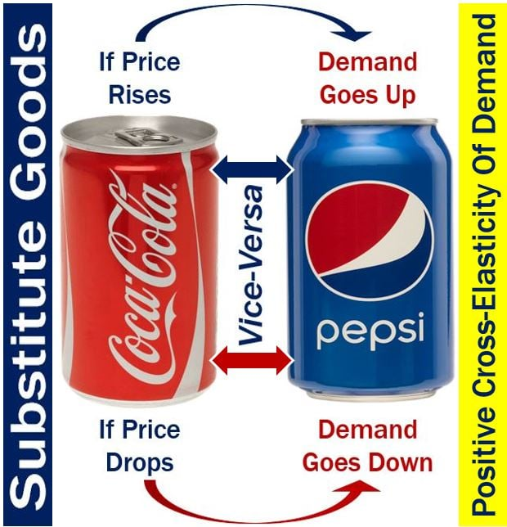

ELASTICITIES OF SUPPLY AND DEMAND
Other Demand Elasticities
income elasticity of demand Percentage change in the quantity demanded resulting from a 1-percent increase in income.
(2.2)
cross-price elasticity of demand Percentage change in the quantity demanded of one good resulting from a 1-percent increase in the price of another.
(2.3)
Elasticities of Supply
price elasticity of supply Percentage change in quantity supplied resulting from a 1-percent increase in price.
What will be cross-elasticity for complementary goods?

Slide 6
Measuring Elasticity ?
Percentage method
Midpoint method
Point or Geometrical (or Graphical) method
Total Outlay Method
Arc Method

Slide 7


Elasticity ?
Percentage method
    computed as
        the percentage change
        in quantity demanded
        divided by the percentage
        change in price

Slide 8


ELASTICITIES OF SUPPLY AND DEMAND
elasticity Percentage change in one variable resulting from a 1-percent increase in another.
Price Elasticity of Demand
price elasticity of demand Percentage change in quantity demanded of a good resulting from a 1-percent increase in its price.
(2.1)
Positive or negative?
Magnitude?

Slide 9
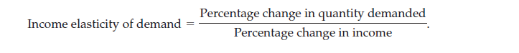

Other Demand Elasticities
Income Elasticity of Demand
Cross-Price Elasticity of Demand

Slide 10

Measuring Elasticity ?
Problem with Percentage Method
From point A to B
Price Increase 50%
Quantity fall by 33%
price elasticity of demand is 33/50, or 0.66.
From point B to A
Price Falls by 33%
Quantity Raise by 50%
price elasticity of demand 50/33, or 1.5.

Slide 11

Midpoint Method
The following formula expresses the midpoint method for calculating the price elasticity of demand between two points, denoted (Q1, P1) and (Q2, P2):
If we go for Midpoint method in the previous problem, then:
Midpoint: Price $5 Quantity 100

Slide 12

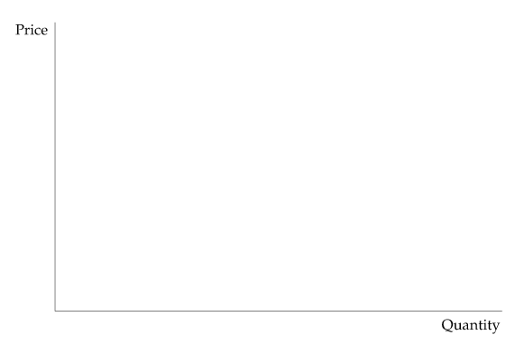
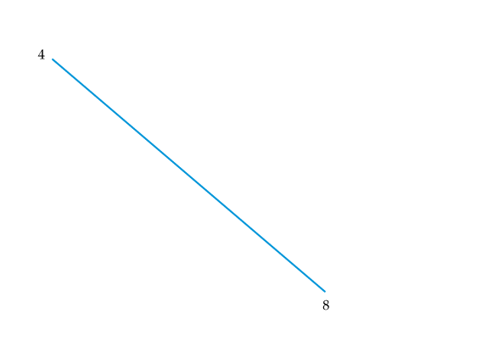
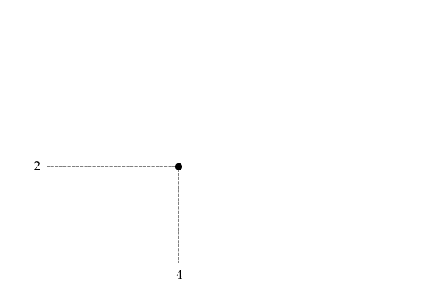
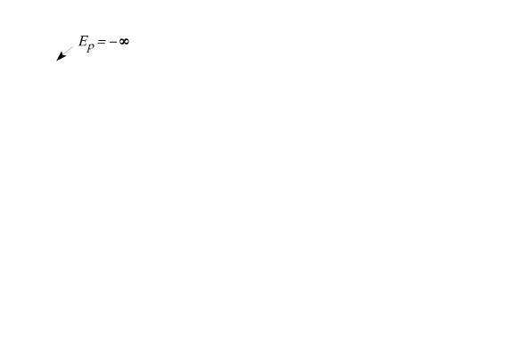
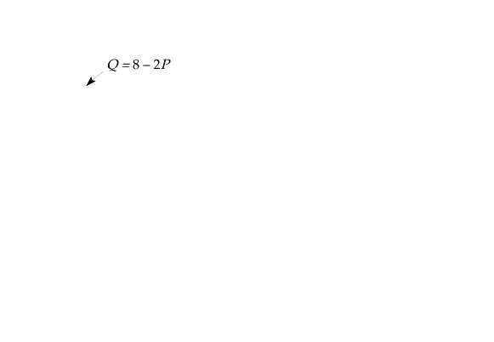
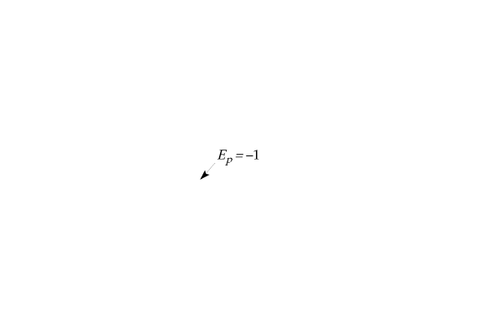
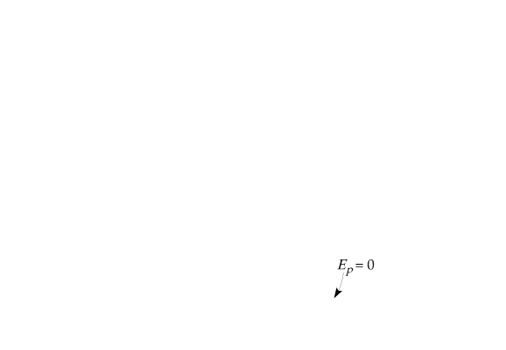
Point or Graphical Method
Linear Demand Curve
linear demand curve Demand curve that is a straight line.
Figure 2.11
Linear Demand Curve
The price elasticity of demand depends not only on the slope of the demand curve but also on the price and quantity.
The elasticity, therefore, varies along the curve as price and quantity change. Slope is constant for this linear demand curve.
Near the top, because price is high and quantity is small, the elasticity is large in magnitude.
The elasticity becomes smaller as we move down the curve.

Slide 13
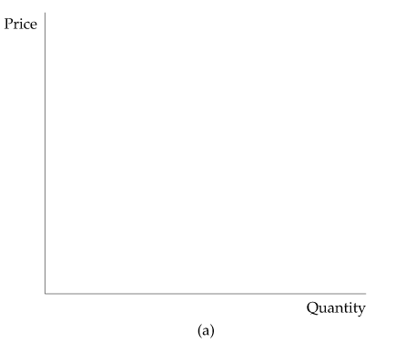
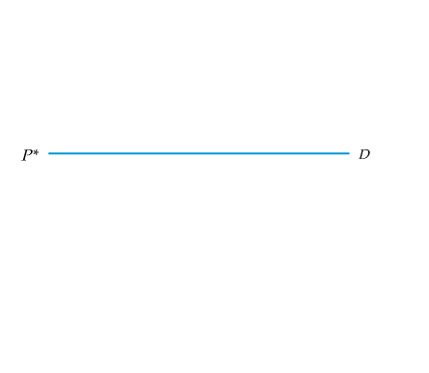
Linear Demand Curve
Figure 2.12
(a) Infinitely Elastic Demand
For a horizontal demand curve, ΔQ/ΔP is infinite. Because a tiny change in price leads to an enormous change in demand, the elasticity of demand is infinite.
infinitely elastic demand Principle that consumers will buy as much of a good as they can get at a single price, but for any higher price the quantity demanded drops to zero, while for any lower price the quantity demanded increases without limit.
Examples- sports vehicles, cruise fares

Slide 14
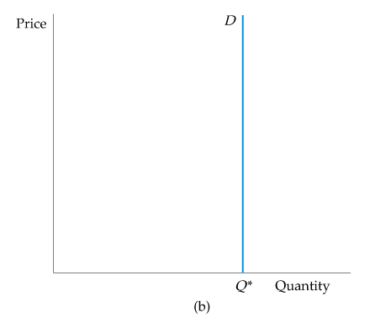
ELASTICITIES OF SUPPLY AND DEMAND
Linear Demand Curve
Figure 2.12
(b) Completely Inelastic Demand
For a vertical demand curve, ΔQ/ΔP is zero. Because the quantity demanded is the same no matter what the price, the elasticity of demand is zero.
completely inelastic demand Principle that consumers will buy a fixed quantity of a good regardless of its price.
Examples- life saving drugs, salt

Slide 15
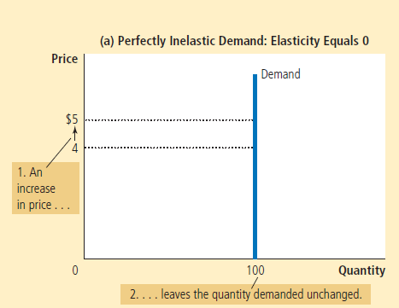
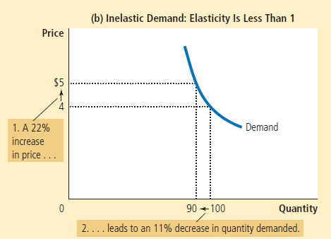
DD curve with various elasticities

Slide 16
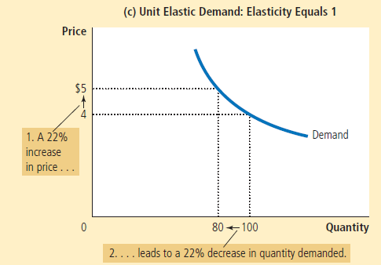
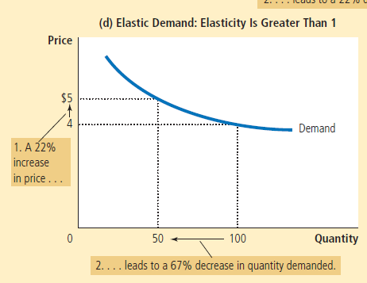
DD curve with various elasticities

Slide 17
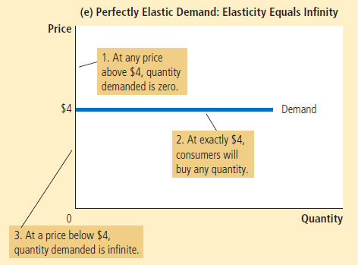
DD curve with various elasticities

Slide 18


Price Elasticity of Demand
Elastic
Inelastic
Tomato Hyundai Car
Car
Salt
-∞
Infinitely Elastic
-4.6 -4.3
-1.3
E = -1
Unitary Elastic
-0.1 0
Completely Inelastic

Slide 19
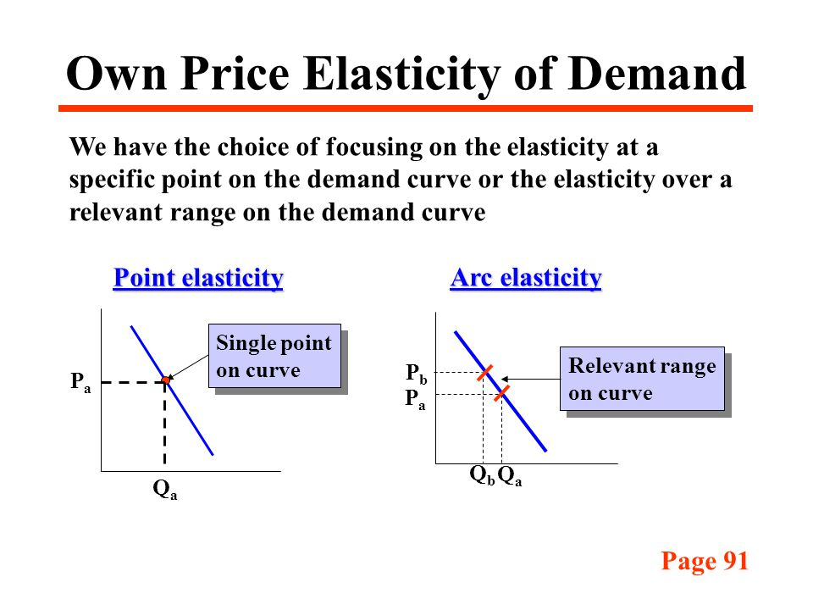
Point versus Arc Elasticities
point elasticity of demand Price elasticity at a particular point on the demand curve.
Arc Elasticity of Demand
arc elasticity of demand Price elasticity calculated over a range of prices.
(2.4)

Slide 20
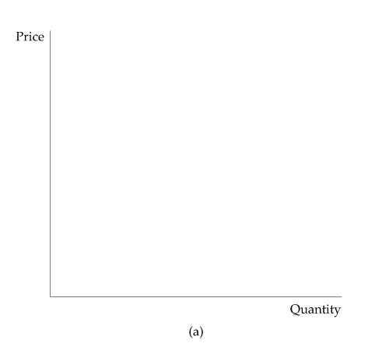
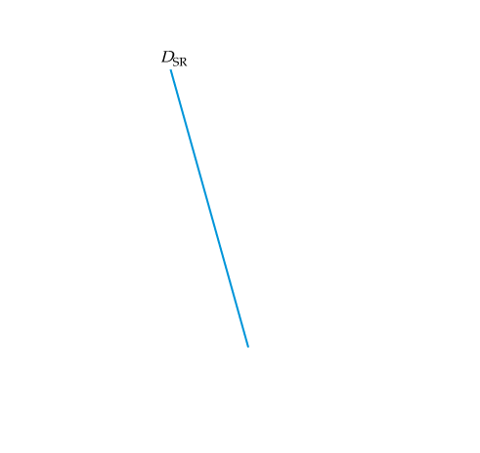
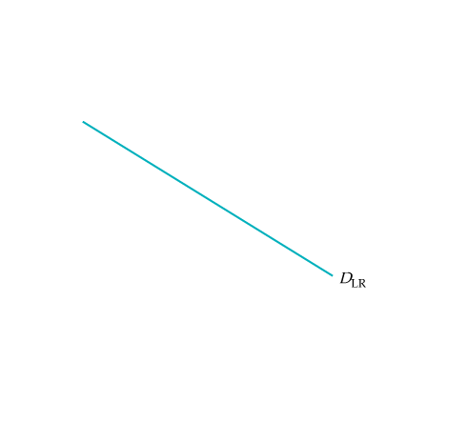
SHORT-RUN VERSUS LONG-RUN ELASTICITIES
Demand
Figure 2.13
(a) Gasoline: Short-Run and Long-Run Demand Curves
In the short run, an increase in price has only a small effect on the quantity of gasoline demanded. Motorists may drive less, but they will not change the kinds of cars they are driving overnight.
In the longer run, however, because they will shift to smaller and more fuel-efficient cars, the effect of the price increase will be larger. Demand, therefore, is more elastic in the long run than in the short run.

Slide 21
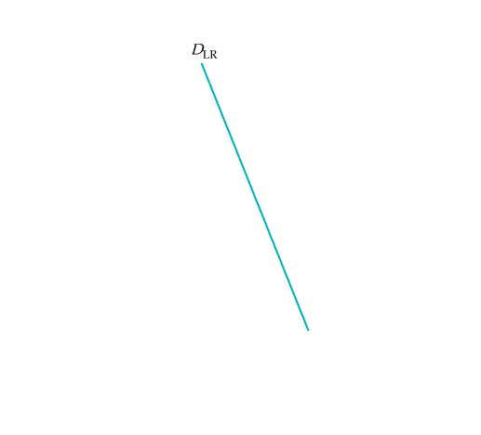
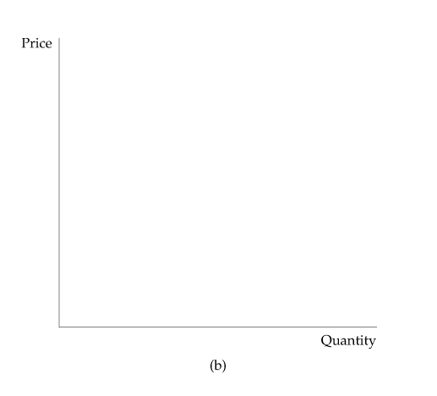
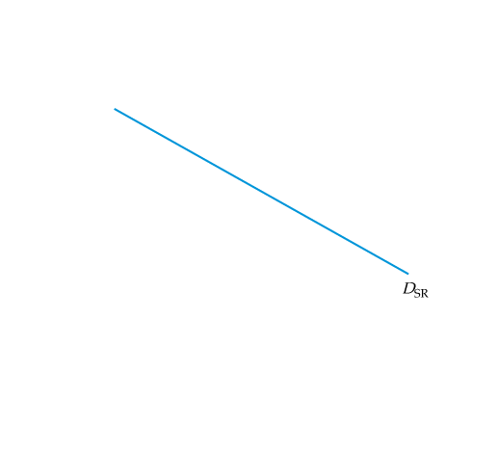
SHORT-RUN VERSUS LONG-RUN ELASTICITIES
Demand
Demand and Durability
Figure 2.13
(b) Automobiles: Short-Run and Long-Run Demand Curves
The opposite is true for automobile demand. If price increases, consumers initially defer buying new cars; thus annual quantity demanded falls sharply.
In the longer run, however, old cars wear out and must be replaced; thus annual quantity demanded picks up. Demand, therefore, is less elastic in the long run than in the short run.

Slide 22
SHORT-RUN VERSUS LONG-RUN ELASTICITIES
Demand
Income Elasticities
Income elasticities also differ from the short run to the long run.
For most goods and services—foods, beverages, fuel, entertainment, etc.— the income elasticity of demand is larger in the long run than in the short run.
For a durable good, the opposite is true. The short-run income elasticity of demand will be much larger than the long-run elasticity.

Slide 23

MARKET DEMAND
Market demand curve
Curve relating the quantity of a good that all consumers in a market will buy to its price.
Determining the Market Demand Curve
(1) (2) (3) (4) (5)
Price Individual A Individual B Individual C Market Dd
($) (Units) (Units) (Units) (Units)
  1 6 10 16 32
  2 4 8 13 25
  3 2 6 10 18
  4 0 4 7 11
  5 0 2 4 6

Slide 24
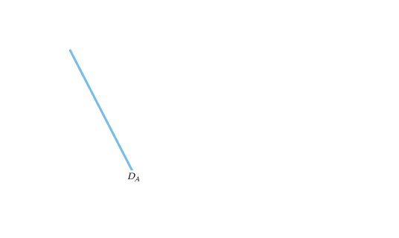
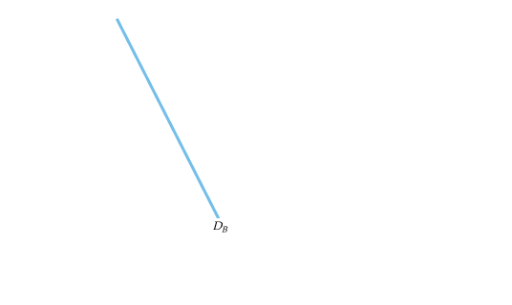
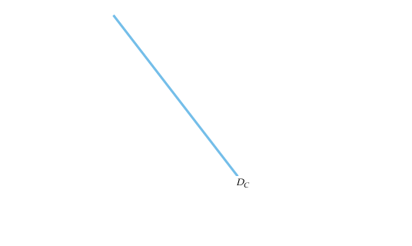
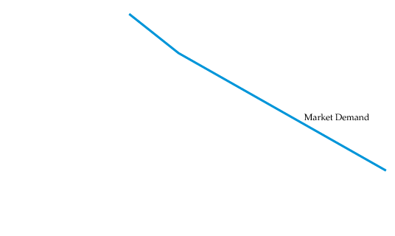


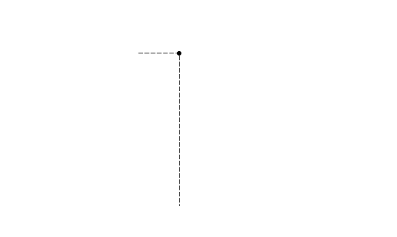
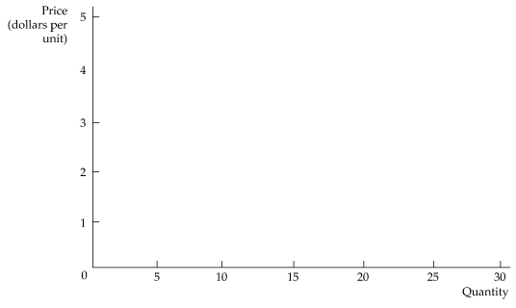
MARKET DEMAND
Figure 4.10
Summing to Obtain a Market Demand Curve
The market demand curve is obtained by summing our three consumers’ demand curves D_{A}, D_{B}, and D_{C}.
At each price, the quantity of coffee demanded by the market is the sum of the quantities demanded by each consumer.
At a price of $4, for example, the quantity demanded by the market (11 units) is the sum of the quantity demanded by A (no units), B (4 units), and C (7 units).

Slide 25
MARKET DEMAND
Two points should be noted:
  The market demand curve will shift to the right as more consumers enter the market.
  Factors that influence the demands of many consumers will also affect market demand.
  The aggregation of individual demands into market becomes important in practice when market demands are built up from the demands of different demographic groups or from consumers located in different areas.
  For example, we might obtain information about the demand for home computers by adding independently obtained information about the demands of the following groups:
    Households with children
    Households without children
    Single individuals

Slide 26

MARKET DEMAND
Elasticity of Demand
Denoting the quantity of a good by Q and its price by P, the price elasticity of demand is
(4.1)
Inelastic Demand
When demand is inelastic, the quantity demanded is relatively unresponsive to changes in price. As a result, total expenditure on the product increases when the price increases.
Elastic Demand
When demand is elastic, total expenditure on the product decreases as the price goes up.

Slide 27
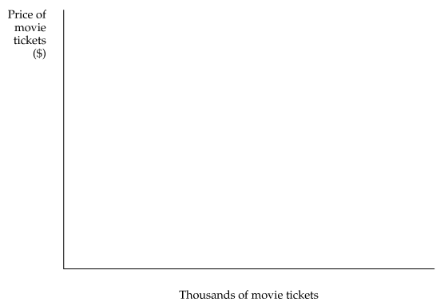
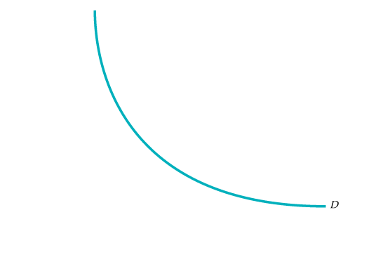
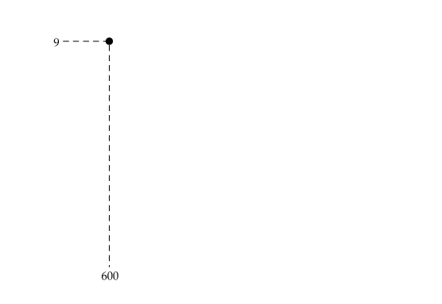
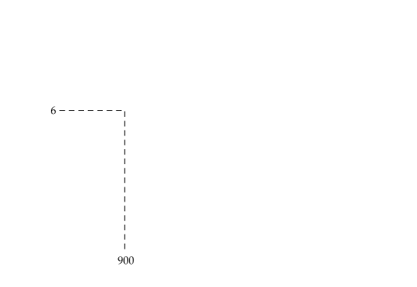
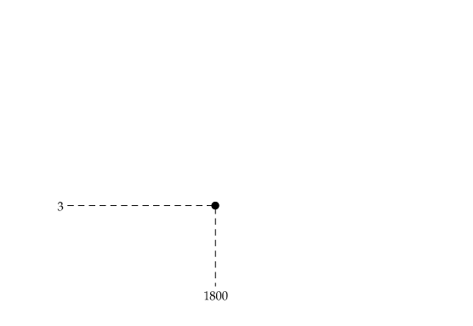
MARKET DEMAND
Elasticity of Demand
Isoelastic Demand
isoelastic demand curve Demand curve with a constant price elasticity.
Figure 4.11
Unit-Elastic Demand Curve
When the price elasticity of demand is −1.0 at every price, the total expenditure is constant along the demand curve D.

Slide 28
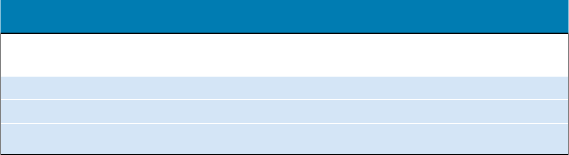
MARKET DEMAND
Elasticity of Demand
Isoelastic Demand
TABLE 4.3 Price Elasticity and Consumer Expenditures
Demand If Price Increases, If Price Decreases,
Expenditures Expenditures
Inelastic Increase Decrease
Unit elastic Are unchanged Are unchanged
Elastic Decrease Increase

Slide 29
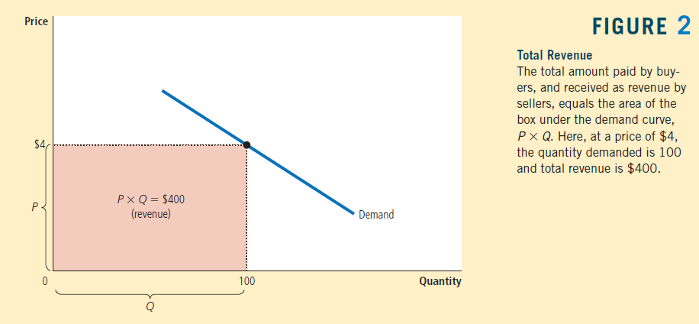
Total Revenue and the Price Elasticity of Demand
Total Revenue
the amount paid by
buyers and received
by sellers of a good,
computed as the price
of the good times the
quantity sold
P × Q

Slide 30
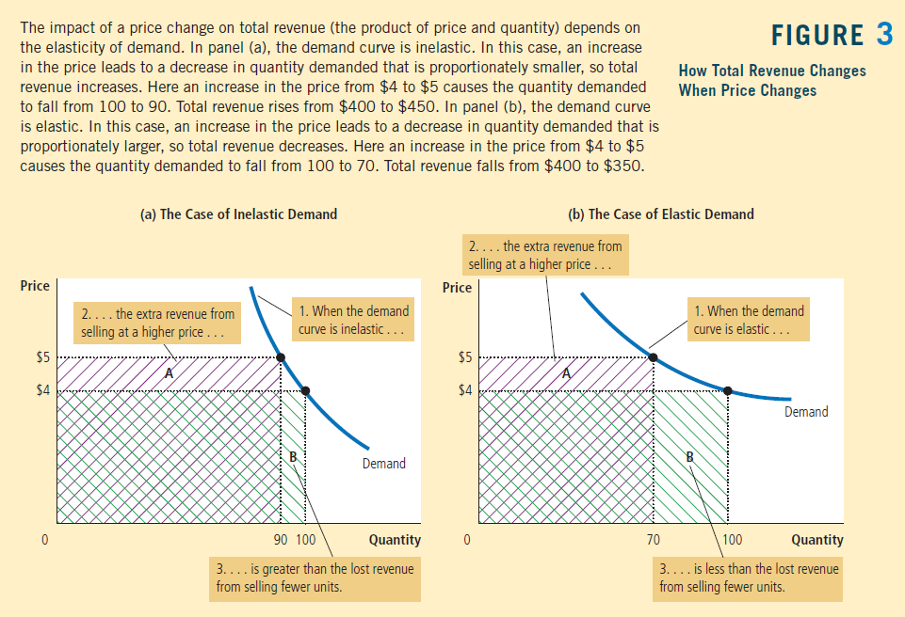

Slide 31
Some general rules:
• When demand is inelastic (a price elasticity less than 1),
    price and total revenue move in the same direction:
    If the price increases, total revenue also increases.
• When demand is elastic (a price elasticity greater than 1),
    price and total revenue move in opposite directions:
    If the price increases, total revenue decreases.
• If demand is unit elastic (a price elasticity exactly equal to 1),
Total revenue remains constant when the price changes.

Slide 32
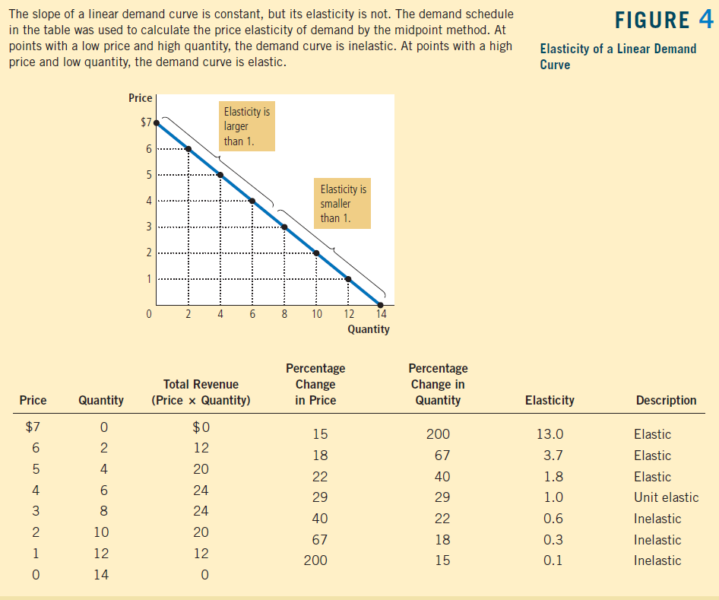

Slide 33
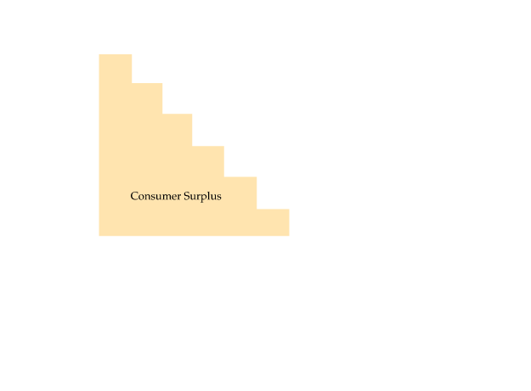
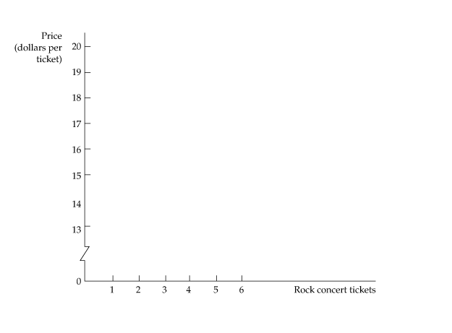

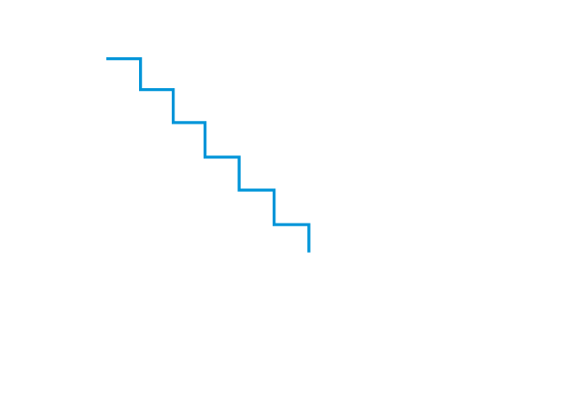
CONSUMER SURPLUS
consumer surplus Difference between what a consumer is willing to pay for a good and the amount actually paid.
Consumer Surplus and Demand
Figure 4.13
Consumer Surplus
Consumer surplus is the total benefit from the consumption of a product, less the total cost of purchasing it.
Here, the consumer surplus associated with six concert tickets (purchased at $14 per ticket) is given by the yellow-shaded area:
$6 + $5 + $4 + $3 + $2 + $1 = $21

Slide 34
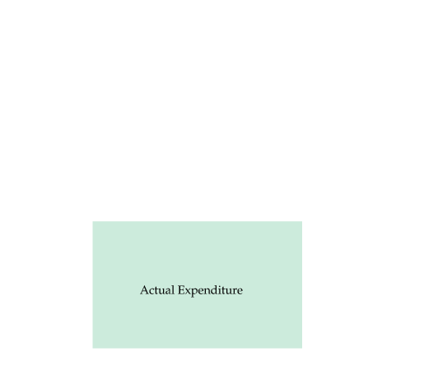
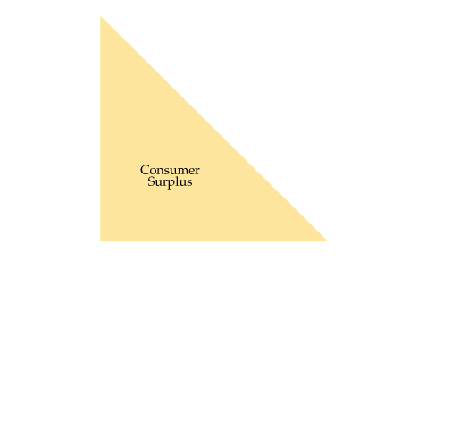
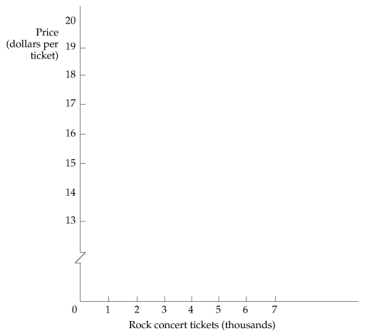
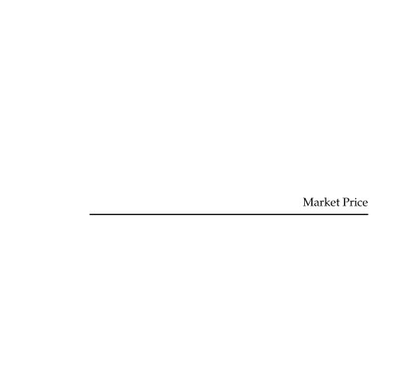

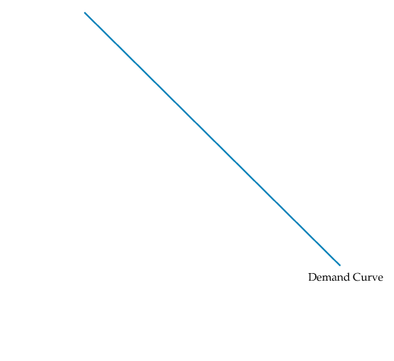

CONSUMER SURPLUS
Consumer Surplus and Demand
Figure 4.14
Consumer Surplus Generalized
For the market as a whole, consumer surplus is measured by the area under the demand curve and above the line representing the purchase price of the good.
Here, the consumer surplus is given by the yellow-shaded triangle and is equal to
1/2 × ($20 − $14) × 6500 = $19,500.

Slide 35
Consumer and Producer Surplus
Individual consumer surplus is the difference between the maximum amount that a consumer is willing to pay for a good and the amount that the consumer actually pays.
Producer surplus for a particular unit of output is the difference between the price at which it is sold and the marginal cost of producing it. Total producer surplus is the sum of producer surplus over all units sold. It equals the difference between revenue and variable costs.

